Slide 1

Employee Management System Data Management with a C Console Application presented by Priya Ranjan Tutor:-Vikash Verma
Techademy final project

Slide 2
Table of contents
1.Introduction
1.1. Purpose of system
1.2. Core Functionalities
2.System Overview
2.1.Features
2.2.Data Storage Approach
3. Code implementation
4.Conclusion

Slide 3
Introduction
Purpose of the System: The Employee Management System is designed to streamline the management of employee data, enabling efficient handling of tasks such as adding, listing, updating, and deleting employee records.
Core Functionalities: This system empowers users with key functionalities:
Add Employee: Enter employee details and store them securely.
List Employees: Retrieve and display stored employee records.
Delete Employee: Effortlessly remove individual employee data.
Update Employee Details: Modify existing employee information with ease.

Slide 4
System Overview
Features :
Add Employee
List Employees
Delete Employee
Update Employee Details
Data Storage Approach:
Utilizing Employee.txt for storing and retrieving data.
File handling benefits: easy data persistence and access.

Slide 5
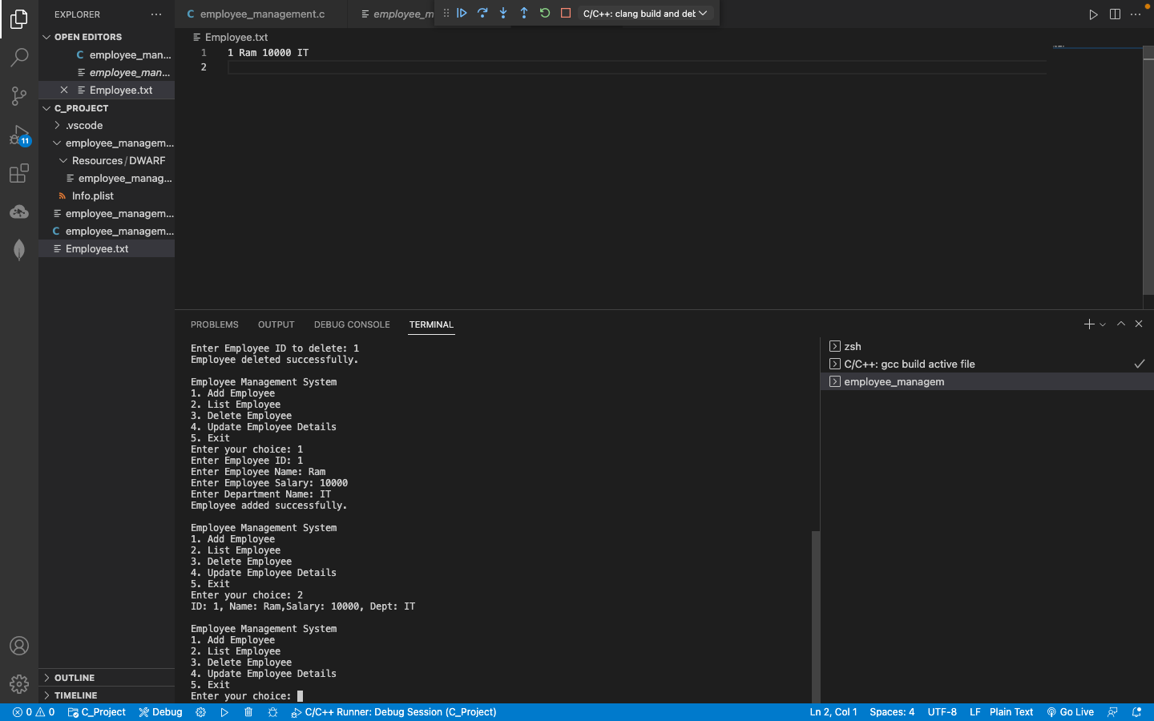
Code implementation
Adding Employees
Listing Employees

Slide 6
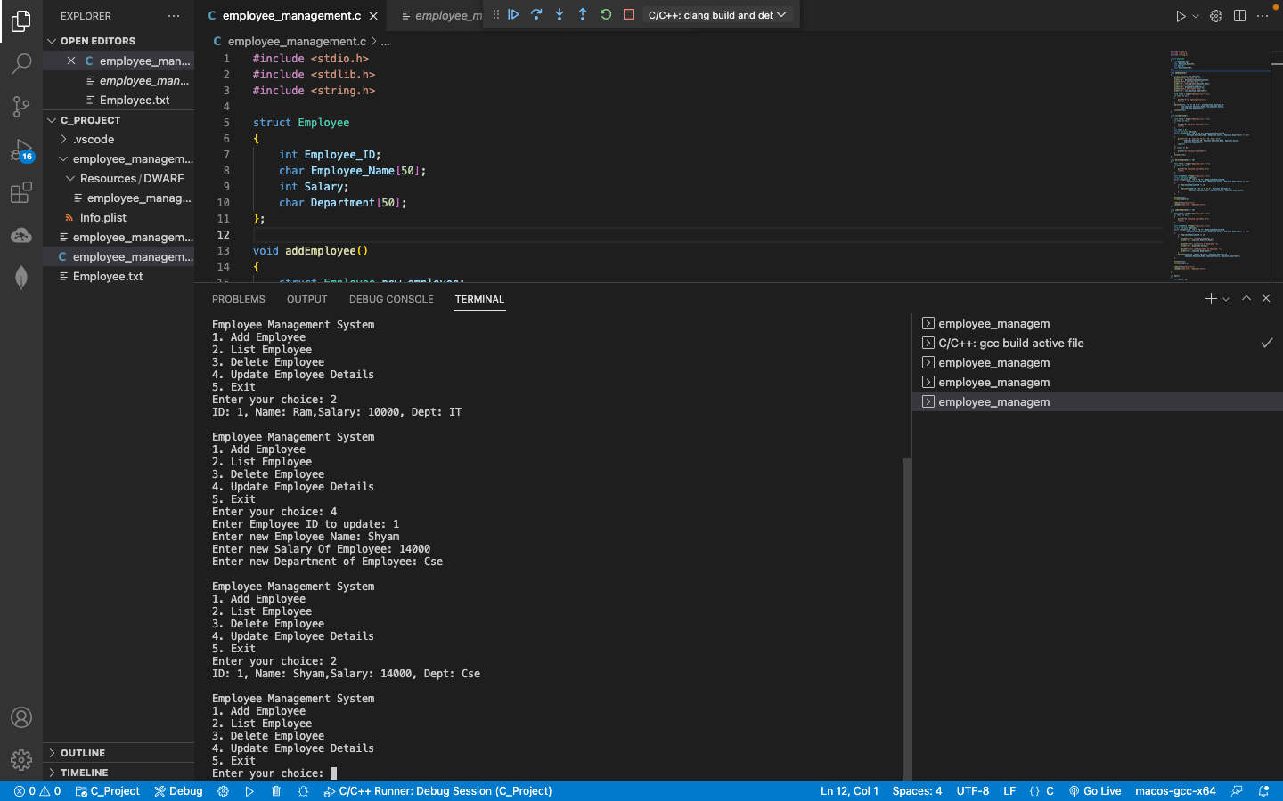
Delete update

Slide 7
Conclusion
System Benefits:
Efficient organization of employee data.
Streamlined processes for data management.
Future Improvements:
Integration with a database system.
Enhanced reporting and analysis features.
Incorporation of additional employee details.

